Slide 1

A Style-Based Generator Architecture for Generative Adversarial Networks
Junlin Han
11/08/2020

Slide 2
Outline
Background
GANs
DCGAN
PGGAN
StyleGAN[1]
Architecture of StyleGAN
Embed images to latent space
Latent space
Style mixing
StyleGAN2[2]
Architecture of StyleGAN2
Dataset
Metrics
Results

Slide 3
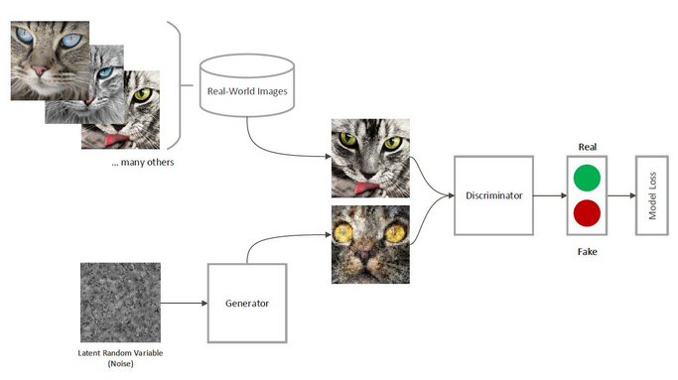
Background GANs(Generative Adversarial Networks) 2014
Notes:
Ian goodflow 2014. Contest between generator and discriminator. When the generator fails to fool the discriminator, it learns from its mistakes and improves itself. Conversely, when the discriminator is fooled, it improves ifself and the contest continues until convergence.

Slide 4
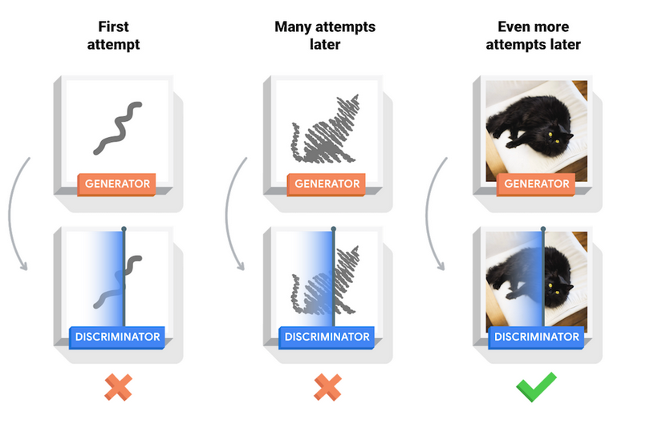
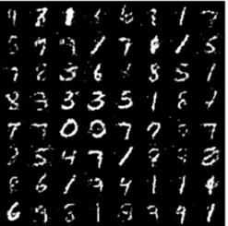
Background GANs(Generative Adversarial Networks) 2014
Convergence
Notes:
Convergence

Slide 5
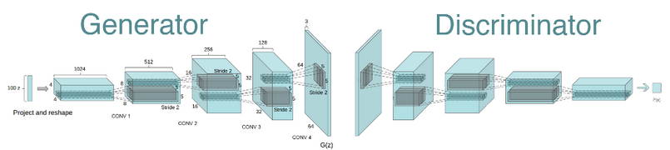
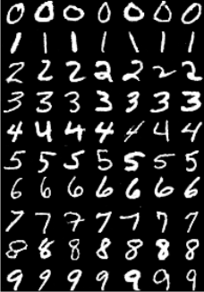
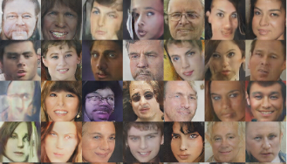
Background DCGAN(Deep Convolutional GAN) 2015
Notes:
Use some techniques from CNN. Batch normalization, activation functions(relu).

Slide 6
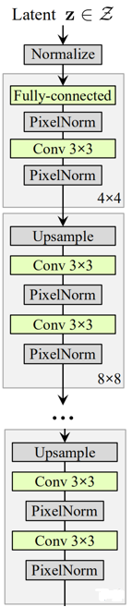
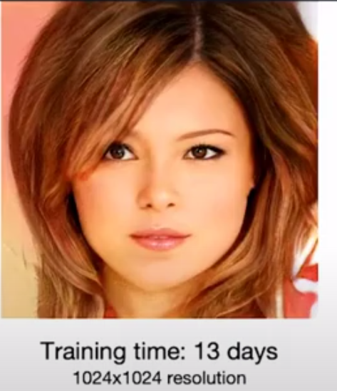
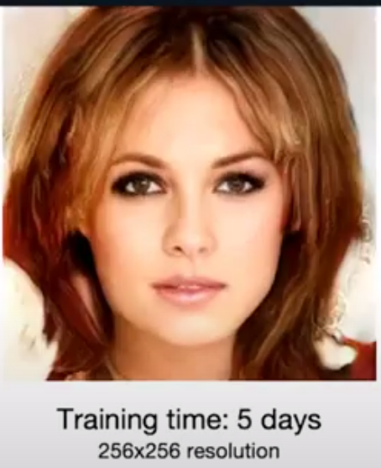
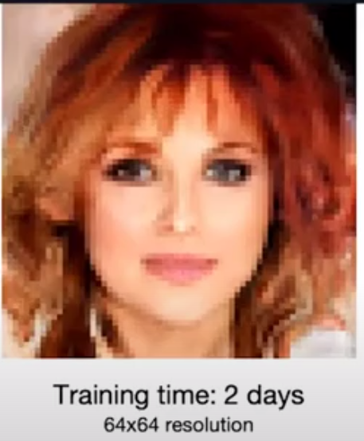
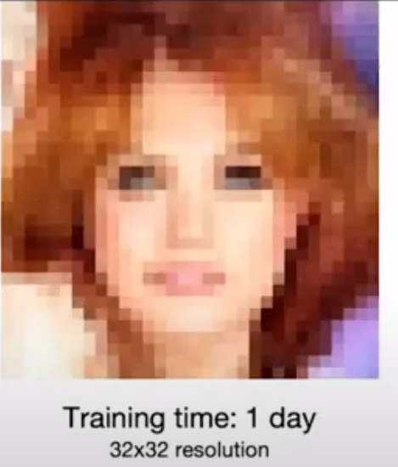
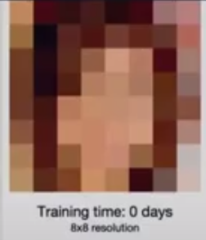
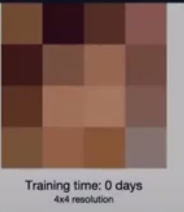


Background PGGAN (progressively grow) 2017
Notes:
The idea of PGGAN(progressively grow). If we want to learn to synthesis high-resolution images like 1024 square, it's very tricky to do so at the beginning. And it's easy for discriminator to tell the difference between real and fake synthesis images. Thus the gradients will be high and the training are not stable. So we start the learning process with low-resolution images like 4*4, after the discriminator can't tell true or false, we go to 8*8... Then reach 1024*1024. Let's see we wanna synthesis a lady, when its

Slide 7
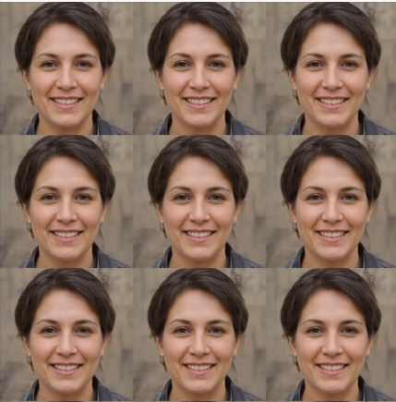
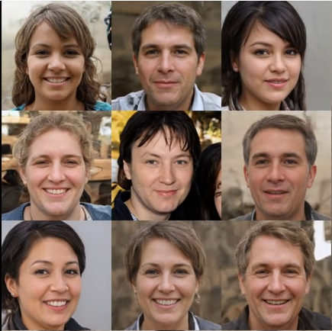
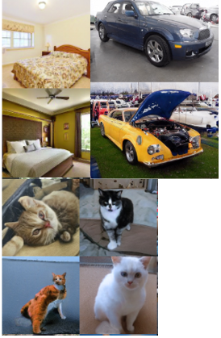
StyleGAN 2019
Notes:
Next stage: How to control the generated images?
Discriminator only needs to tell the truth or false. Focus on the generator.

Slide 8
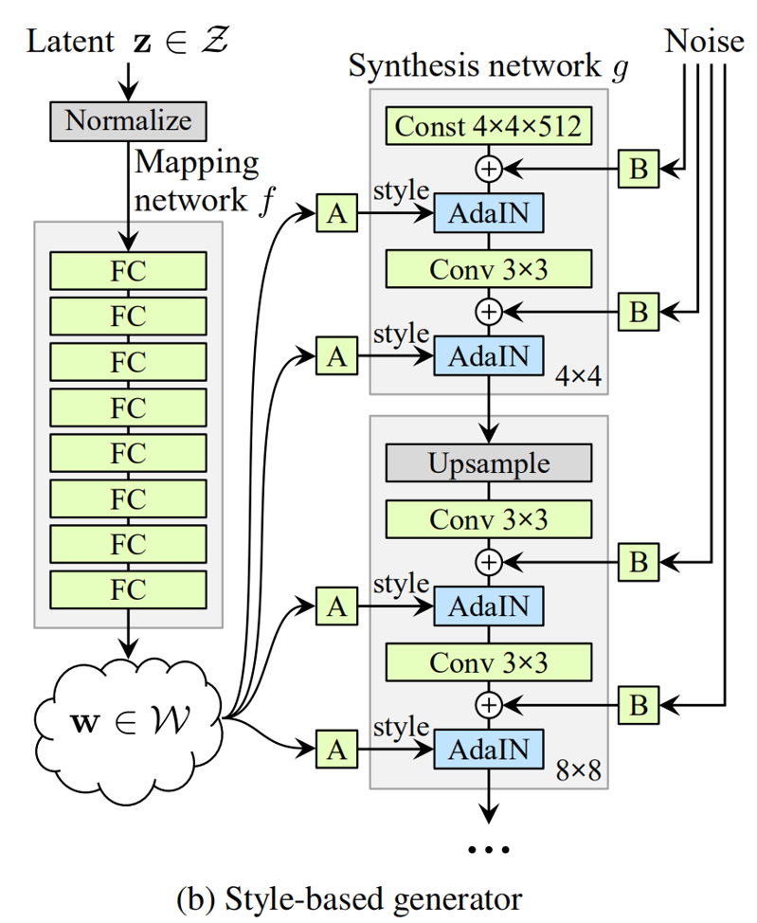
StyleGAN Architecture of StyleGAN
Mapping network: Map the input latent code z to an intermediate latent space W.
Affine transform A: To insert the learned “style” to network.
AdAIn: Adaptive instance normalization.
Per-channel Noise scale B: Scale the noise input.
Notes:
1: non linear mapping to avoid feature entanglement
2: Control the intensity of style. In 4*4, it control the faces' size,rough hair style,pose. In 32*32,middle features like open/closed eyes, size of noses. In 1024*1024, affect the small features like color tons of background. Thus we can control how much styles we want in different features.
3:ADAIN : Do normalization for input. Each convolution weight Independent.
4: Feed a dedicated noise to each layer of the generator network. Noise are added to add the diversity. Eg, single hair's shape and placement, pores' location, stubble. These noise wont effect the images main structure and high-dimensional meaning.

Slide 9
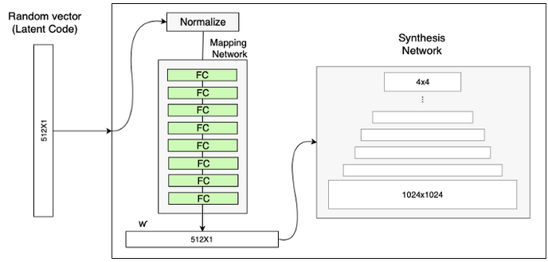
Architecture of StyleGAN Mapping network
If images of people with black hair are more common in a dataset, then more input values will be mapped to that feature. As the result, the model isn’t capable of mapping parts of the input to feature, which cause features entanglement.
Notes:
Mapping network can generate a vector that doesn’t have to follow the training data distribution and can reduce the correlation between features. Example; eyes/glasses. Hair color/length.

Slide 10
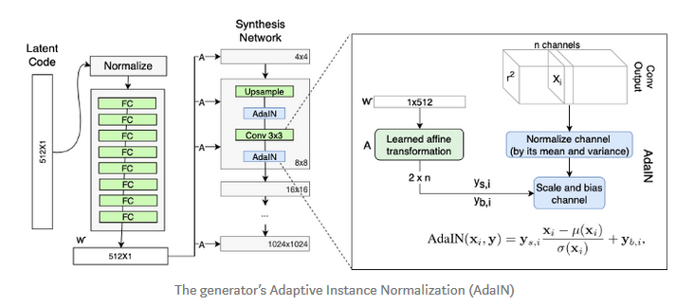
Architecture of StyleGAN Affine transform and AdaIN
Each style controls only one convolution.
Notes:
AdaIn can do not depend on the original statistics because of the normalization. Thus each style controls only one convolution.

Slide 11
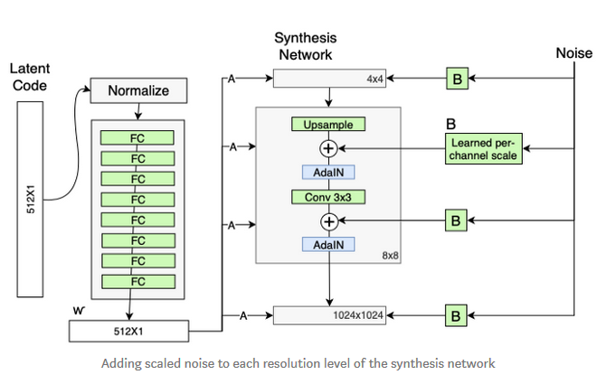
Architecture of StyleGAN Per-channel Noise scale
Noise are added to add the diversity.
Notes:
Feed a dedicated noise to each layer of the generator network. Noise are added to add the diversity. Eg, single hair's shape and placement, pores' location, stubble. These noise wont effect the images’ main structure and high-dimensional meaning

Slide 12
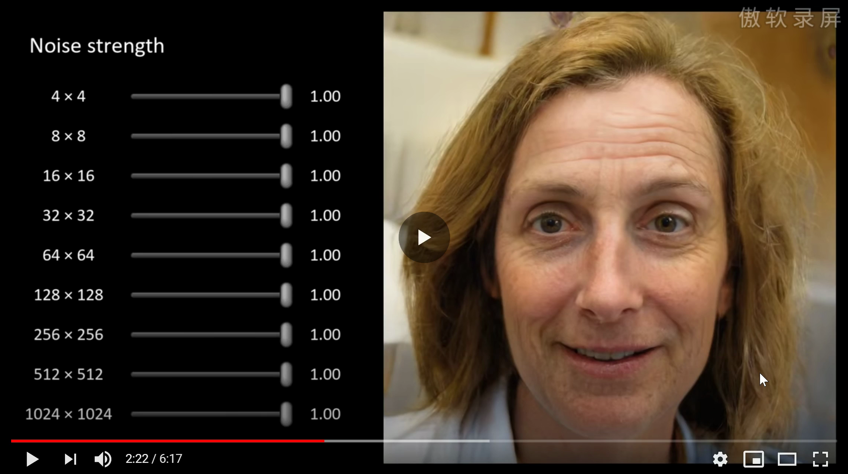
Notes:
Coarse features 4-8. Middle features 16-32. Fine features 32-1024. low-resolution: hair background, shape. Fine features: Focusing on the skin.

Slide 13
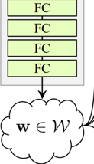
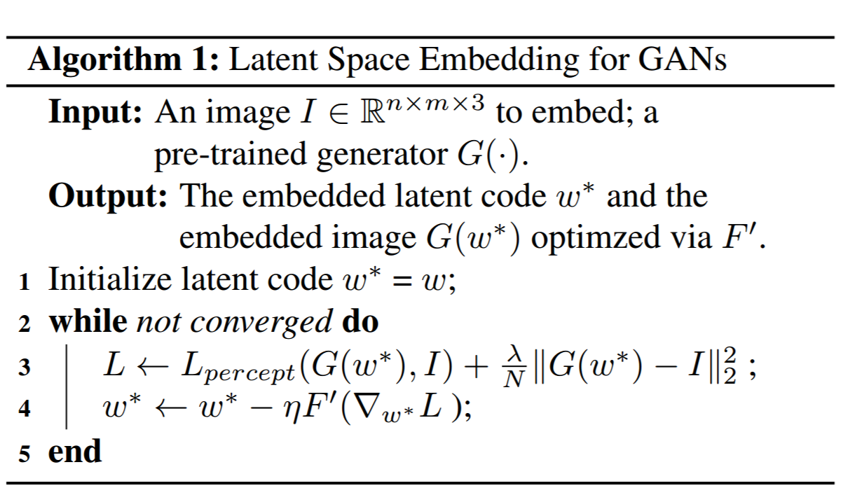
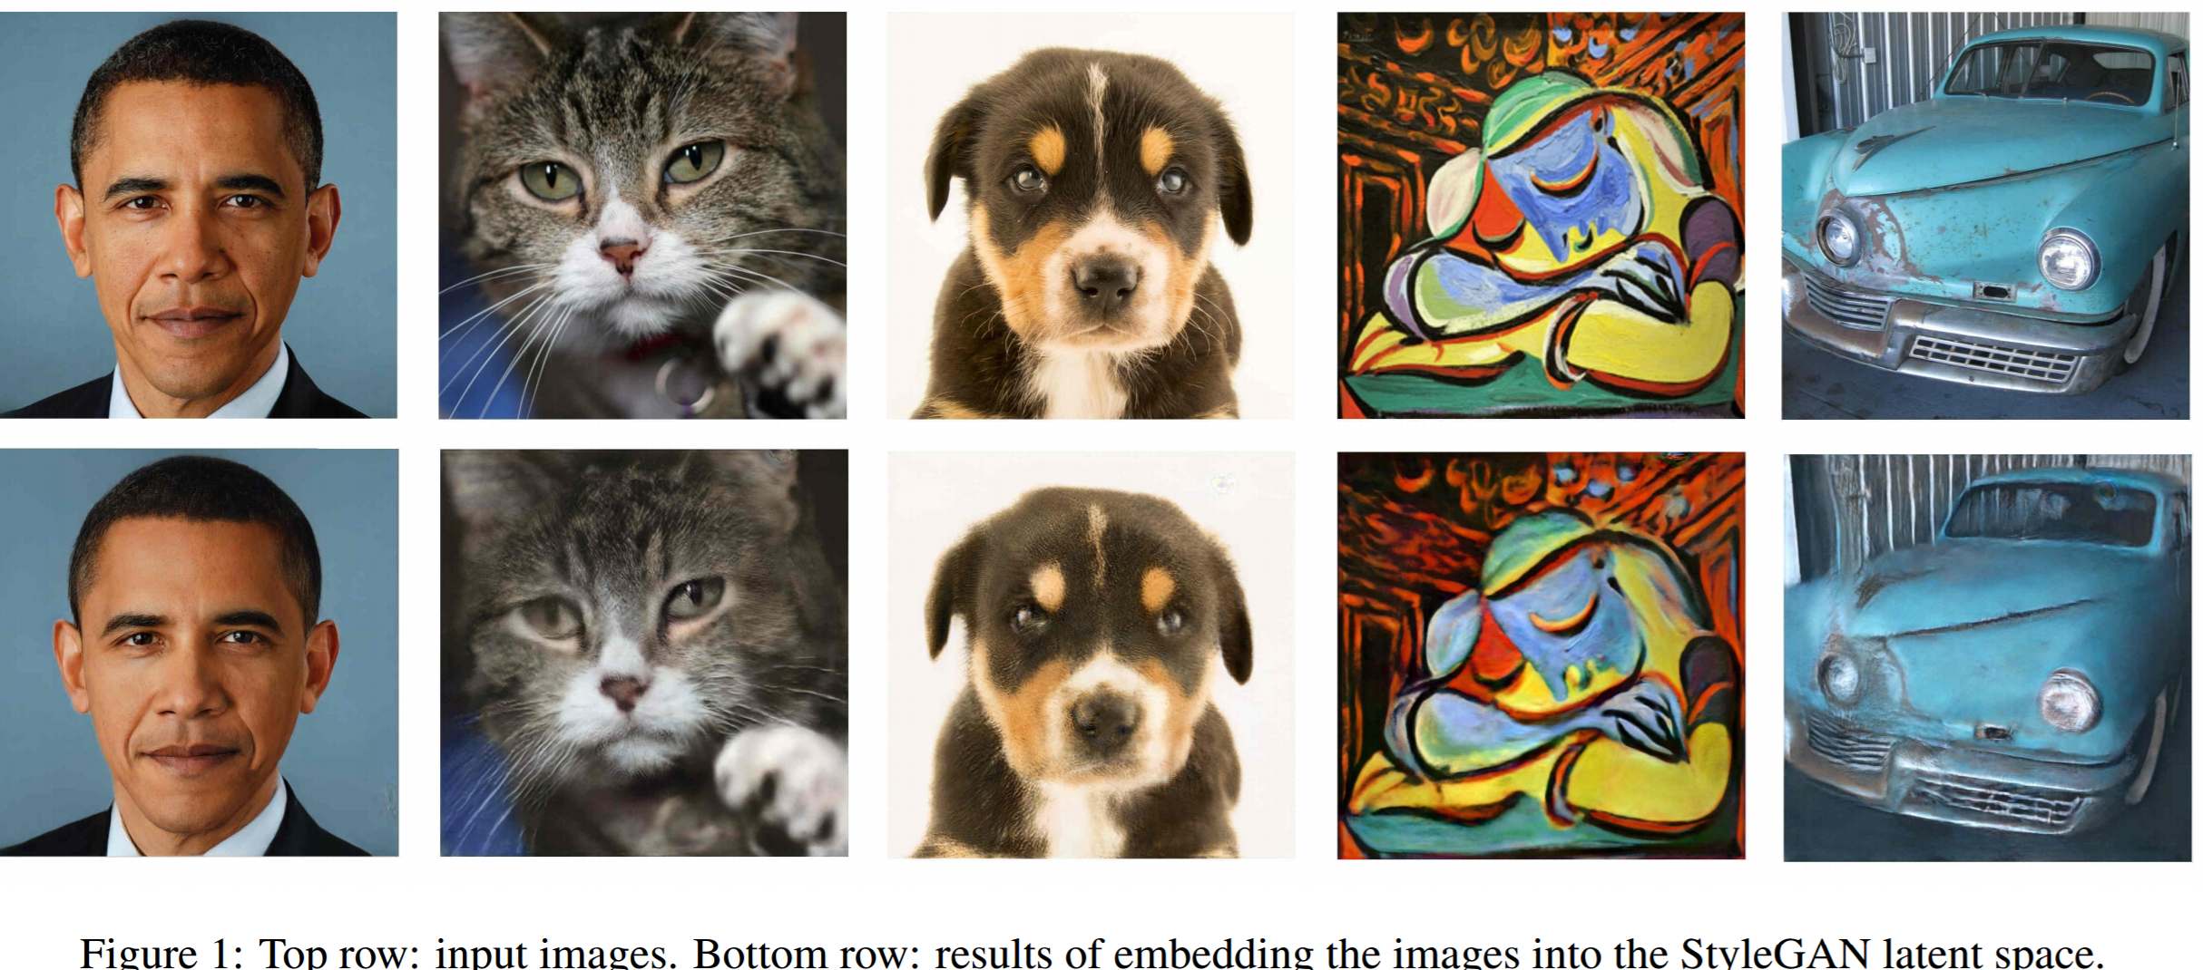
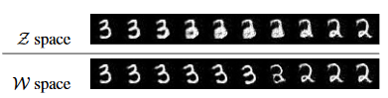
StyleGAN Embed images to latent space
Learn an encoder that maps a given image to the latent space[3].
Select a random initial latent code and optimize it using gradient descent[4].
Notes:
A weighted combination of the VGG-16 perceptual and MSE loss.
Extended latent space W+. W+ is a concatenation of 18 different 512-dimensional w vector since style gan use w for 18 times.

Slide 14
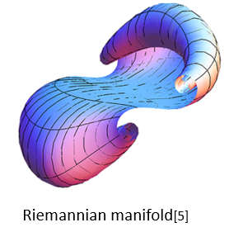
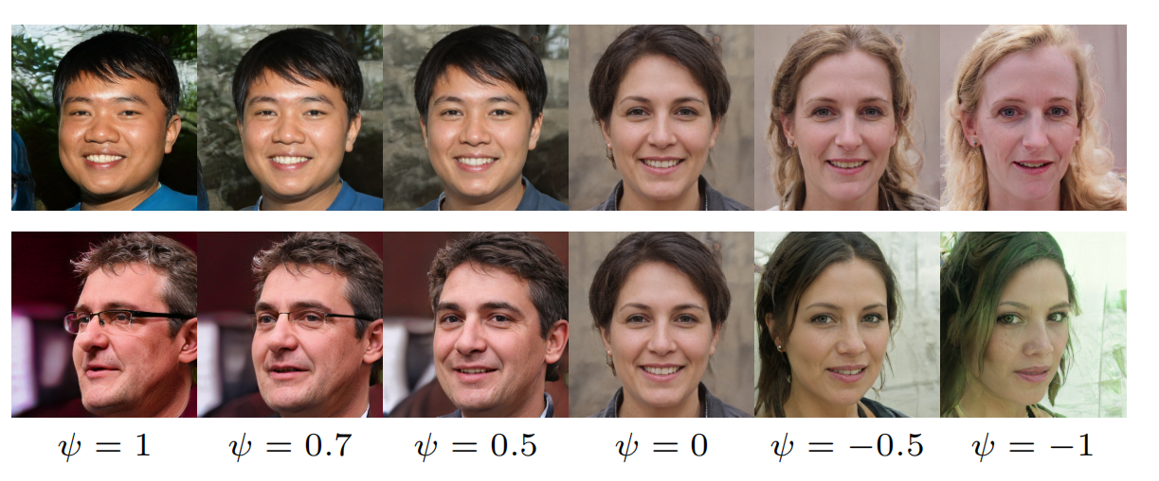
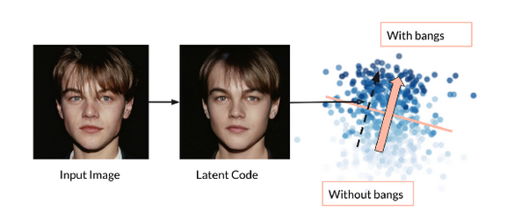
StyleGAN Latent Space
Areas of low density in latent space are poorly represented and
likely to be difficult for the generator to learn.
Truncation:
Choosing ψ = 0.7 gives high-quality output with variation in features.

Slide 15

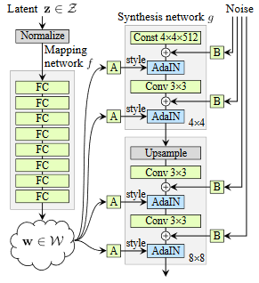

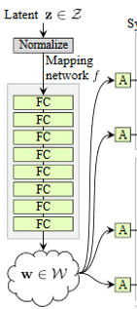
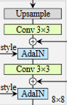
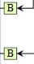
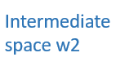
StyleGAN Style Mixing
Run two latent codes z1,z2 through the mapping network, and have the corresponding w1,w2 control the styles so that w1 applies before the split point and w2 after it.
Notes:
Parents predict children.

Slide 16
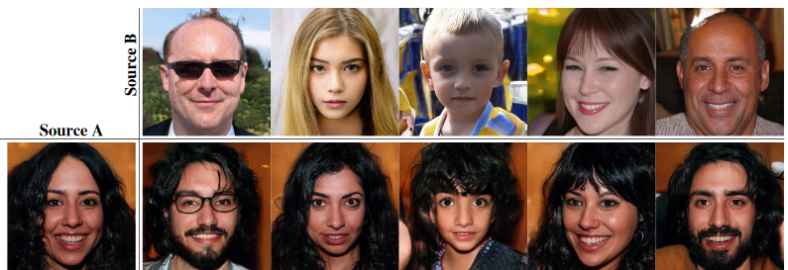
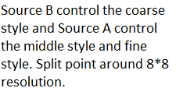
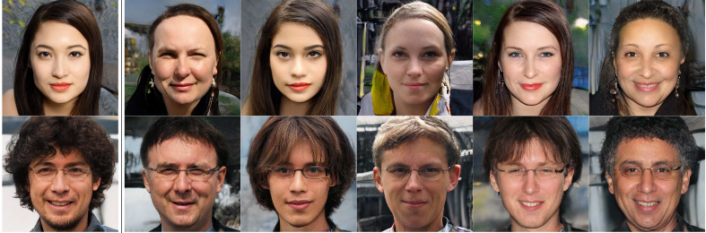
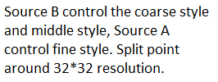
StyleGAN Style Mixing
Notes:
A split point in the synthesis network is chosen. Copying the styles(B) corresponding to coarse resolutions (4–8) brings high-level aspects such as pose, general hair style, face shape, and eyeglasses from source. while all colors(eyes, hair, lighting)are from B.

Slide 17
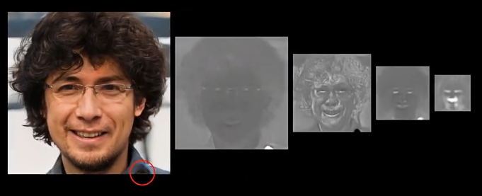
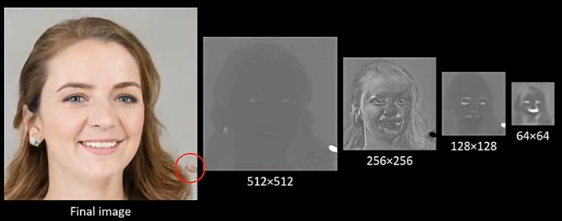
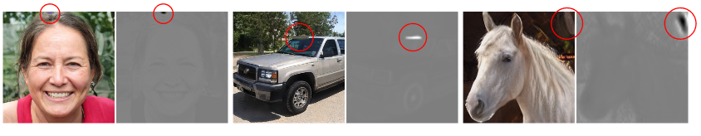
StyleGAN2
StyleGAN is not perfect.
The existence of water
droplet artifact is the
biggest drawback.

Slide 18
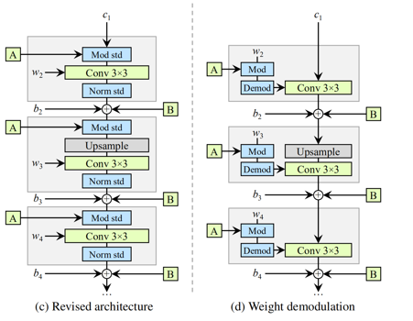
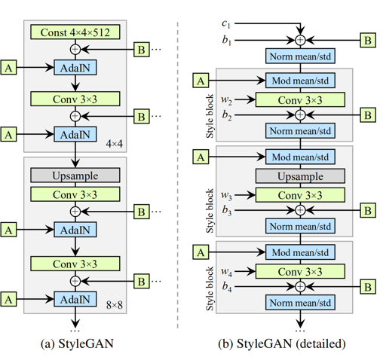
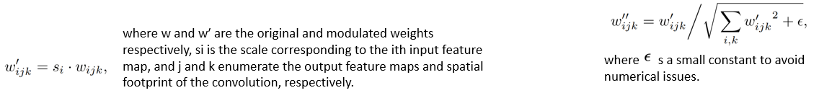
StyleGAN2 Architecture
Notes:
(c) We make several changes to the original architecture. We remove some redundant operations at the beginning, move the addition of b and B to be outside active area of a style, and adjust only the standard deviation per feature map.
(d) The revised architecture enables us to replace instance normalization with a “demodulation” operation, which we apply to the weights associated with each convolution layer.
StyleGan2 also improves the discriminator by adding the skip connections(unet). They also revised their progressive training(mostly due to resolution usage,1024*1024 are not good used in percentage).
Now, the purpose of instance normalization is to essentially remove the effect from the statistics of the convolution’s output feature maps. We observe that this goal can be achieved more directly. Let us assume that the in-put activations are i.i.d. random variables with unit standard deviation. After modulation and convolution, the output activations have standard deviation of rightest part.

Slide 19
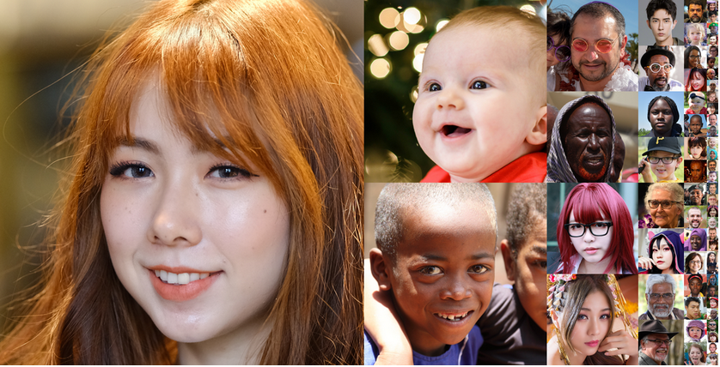
StyleGAN2 Dataset
Flickr-Faces-HQ Dataset (FFHQ) : 70000 high-quality PNG images at 1024×1024 resolution and contains considerable variation in terms of age, ethnicity and image background.

Slide 20
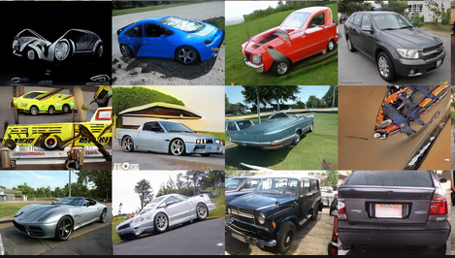
StyleGAN2 Dataset
LSUN: Construction of a Large-scale Image Dataset using Deep Learning with Humans in the Loop[6].
One million labeled images for each of 10 scene categories and 20 object categories.
Cars: 512x384 resolution.

Slide 21
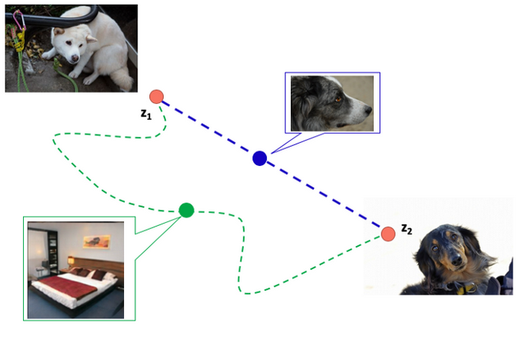
StyleGAN2 Metrics
Frechet Inception Distance (FID) is a measure of similarity between two datasets of images. It was shown to correlate well with human judgement of visual quality and is most often used to evaluate the quality of samples of Generative Adversarial Networks.
Perceptual Path Length (PPL) is an indicator of whether the image changes smoothly in “perceptual”. Using a pre-trained network (VGG16) to classify perceptual distance between images.
Notes:
Suppose we have a latent variable z1 that produces a white dog and a latent variable z2 that produces a black dog. Since the elements other than color are not changed, taking the intermediate data, it is ideal that the latent variable changes along a path that changes between white and black. The blue path that changes color only is the “perceptually” shortest distance

Slide 22
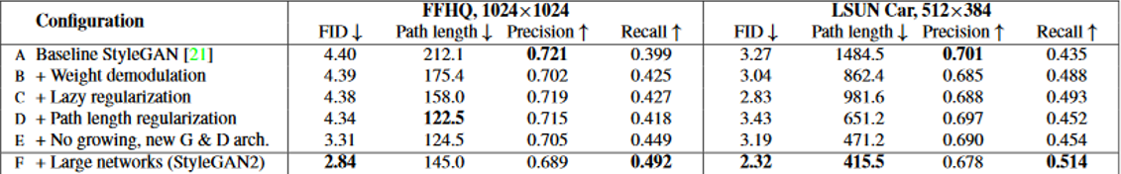
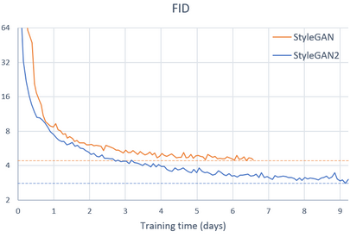
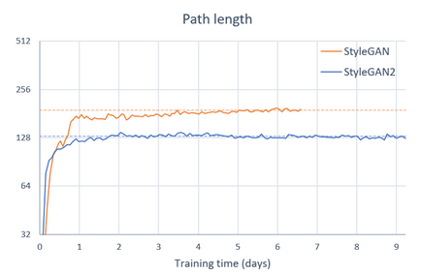
Results
Notes:
Lazy: no harm is caused when R1 regularization is performed only once every 16 minibatches.
Path: Encourage that a fixed-size step in W results in a non-zero, fixed-magnitude change in the image.
No growing: Skip connections(generator), residual networks(discriminator)
Large the contributions from the high-resolution layers in specific the 1024 × 1024 layers are not contributed as much as it should be

Slide 23
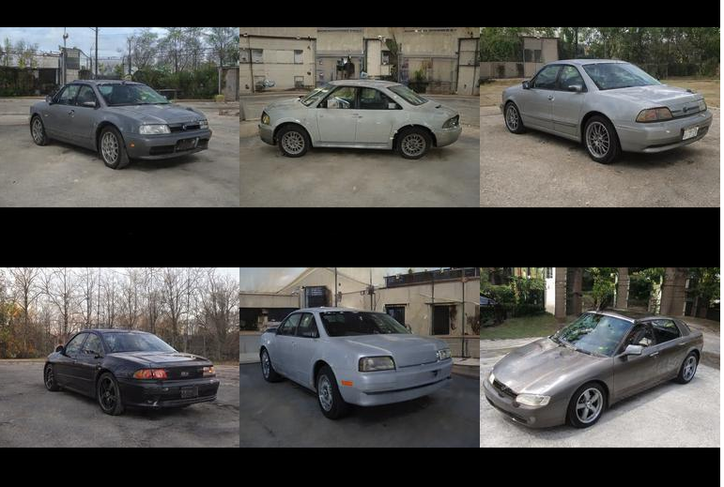
Results Cars

Slide 24

Results Cats

Slide 25

Results Church

Slide 26

Results WikiArt

Slide 27

Results Anime portraits

Slide 28

Results Abstract art

Slide 29

Results Maps

Slide 30


Results Faces
Credits :[7]

Slide 31
Reference
[1]Tero Karras and Samuli Laine and Timo Aila. A Style-Based Generator Architecture for Generative Adversarial Networks. Computer vision and pattern recognition(CVPR),2019.
[2]Tero Karras and Samuli Laine and Miika Aittala and Janne Hellsten and Jaakko Lehtinen and Timo Aila. Analyzing and Improving the Image Quality of StyleGAN. Computer vision and pattern recognition(CVPR),2020.
[3]Rameen Abdal and Yipeng Qin and Peter Wonka. Image2StyleGAN: How to Embed Images Into the StyleGAN Latent Space?. Computer vision and pattern recognition(CVPR),2019.
[4]Stanislav Pidhorskyi and Donald A. Adjeroh and Gianfranco Doretto. Adversarial Latent Autoencoders. Computer vision and pattern recognition(CVPR),2020.
[5]Yujun Shen and Jinjin Gu and Xiaoou Tang and Bolei Zhou. Interpreting the Latent Space of GANs for Semantic Face Editing. Computer vision and pattern recognition(CVPR),2020.
[6]Fisher Yu and Ari Seff and Yinda Zhang and Shuran Song and Thomas Funkhouser and Jianxiong Xiao. LSUN: Construction of a Large-scale Image Dataset using Deep Learning with Humans in the Loop. arXiv:1506.03365,2015.
[7]Yuri Viazovetskyi and Vladimir Ivashkin and Evgeny Kashin. StyleGAN2 Distillation for Feed-forwardImage Manipulation. European Conference on Computer Vision(ECCV),2020.

Slide 32

Thanks!
Feel free for any questions.
Contact: Junlin.Han@data61.csiro.au

